Slide 1
Basic Linux Commands
Kay Kasemir
July 2026

Slide 2
Why Linux?
Free, open source
Made for the network/internet
  File servers, web servers tend to run on Linux
  Tools for remote access are built-in
  EPICS “IOC” typically runs as Linux services
Desktop Linux does offer a GUI, but terminal is often more effective and also available via remote access
Where did you click?
Left or right mouse button?
I typed
cd /ics/examples/07_stream

Slide 3
Getting around the file system
Change Directory
  Cd Back to home folder
  cd /ics/examples/01_first_steps Go to that folder
  cd /ic ^{TAB} ex ^{TAB} 01 ^{TAB} Less to type
  cd .. Up one
Show Current Directory (if not shown in terminal prompt or title)
  pwd
List files
  ls
  ls -l

Slide 4
Dealing with Files
Open in Text Editor
  nano name_of_file
  gedit name_of_file &
  gedit nam^{TAB} &
  may use vdct instead of gedit for EPICS database file
Quickly look at a file
  cat name_of_file
  less name_of_file (cursor up/down, ‘h’ for help)
Copy File
  cp name_of_file new_file_name
Remove/Delete file
  rm name_of_file

Slide 5
Common EPICS Commands
Channel Access
  caget pv_name
  camonitor pv_name
  caput pv_name new_value
  cainfo pv_name
Start IOC
  softIoc –m “MACRO=value” –d example.db
  ./st.cmd
Start CS-Studio
  css

Slide 6
Common IOC Commands
List Records
  dbl
Print fields of one record
  dbpr name_of_record 10
‘Put’ value of a field
  dbpf name_of_record.SCAN “.1 second”

Slide 7
Essential File System Layout
/ics/examples/01_first_steps/*.db Database for ‘softIoc –m S=demo –d xxx.db’
/ics/examples/06_autosave makeBaseApp module. ‘make’ here
/ics/examples/06_autosave/demoApp/Db/*.db Add/edit *.db files here
/ics/examples/06_autosave/demoApp/Db/Makefile ‘DB += my_new.db’ in here
/ics/examples/06_autosave/demoApp/src/Makefile Add ‘…_DBD’ and ‘.._LIBS’ for required modules
/ics/examples/06_autosave/iocBoot/iocdemo/st.cmd Run IOC as ‘./st.cmd’
/ics/examples/06_autosave/db, lib, bin, include, … ignore…
/ics/examples/RELEASE.local All ‘configure/RELEASE’ files include this
/ics/README.md How all of this was created

Slide 8
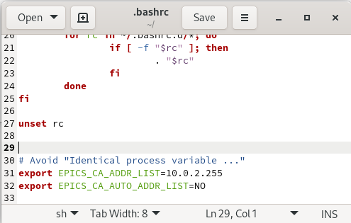
VM Notes
VM isn’t perfect, but provides everybody with the same setup
Slower than “native” setup
Quirky window resizing
  Try View, Virtual Screen, Zoom 200%
Slow channel access connection (on Mac)
  “disable_dns” in terminal
“Identical process variable …”
warning:
  gedit ~/.bashrc

